Slide 2
Caltech Financials Data Warehouse Costs & Commitments

Slide 3
Agenda
OBI Security: Cost Details
Data Warehouse Redesign
Financial Subject Areas
Data Concepts and Logic
Accessing Reports
Tips and Hints
FAQ

Slide 4
OBI Security: Cost Details

Slide 5
OBI Security: Cost Details
OBI User Roles determine access to reports
Financial data mart has three main roles
Financial Campus User
Access to a specific set of reports
Financial Division User
Same access as Campus User, plus additional reports
Financial Finance User
Same access as Division User, plus additional reports
Notes:
OBI User Roles determine to which reports you will have access
The Financial data mart has three main roles:
Financial Campus User
Majority of users have this role
Access to a specific group of reports
Financial Division User
Smallest user group
Same access as the Campus User, plus additional reports
Sees both roles on their dashboard
Financial Finance User
Same access as Division User, plus additional reports
Sees all three roles on their dashboard
Reason: So the Finance Users can go into a report with the same navigation as a Campus User
Tip: Use the Finance role unless specifically assisting somebody on campus

Slide 6
OBI Security: Cost Details
Row-level security controls specific data access
PTA-level access determines to which PTAs a user can see
Can be given by Organization, PI, Award, Award-Project, Project, Project-Task, and PTA
Specific values can also be excluded
Salary-level access determines if the user can see Expenditure Types flagged in setups as compensation-related
Able to mix and match the PTA and Salary access
Notes:
While the roles control to which reports you have access, there is additional security on the data itself
Row-level security controls the specific data access
PTA-level access determines to which PTAs a user can see
Can be given by Organization (Project, Task, and Award Org), PI (Project, Task, and Award Manager), Award, Award-Project, Project, Project-Task, and PTA
Specific values can also be excluded, e.g., All BBE PTAs, except for this specific GB award
Tip: Give access at the highest level possible, e.g., Award instead of PTA
Salary-level access determines if the user can see Expenditure Types that have been flagged in the Oracle setups as compensation-related
The access may be a mix of PTA-level and Salary-level access, e.g., access to these six awards with salary-level, and access to these two other awards, but with no salary-level access, i.e., can only see the costs related to non-salary expenditure types

Slide 7
Data Warehouse Redesign

Slide 8
Data Warehouse Redesign
Integrates a comprehensive set of Financials data
Design based on campus users’ data needs
Cost Incurred For logic
Provider logic
Enhanced Expenditure Comment
Tax lines linked to item lines
Drill to detail (e.g., GA line item to AP/PO detail)
You will have more information available
Less reliant on Finance staff to research items
Notes:
The Cognos data design has data segregated by subject area.
For example, you can not mix Grants Accounting data with Procurement or Labor Distribution data
OBI integrates a comprehensive set of Financials data.
There is now the ability to connect a cost to the Procurement invoice, see the payment date, and look at details about the PO.
OBI’s data design is based on the needs to the campus users and includes new concepts and functionality such as:
Cost Incurred For (CIF) logic.
Who was that cost for?
Provider logic.
Who provided the cost, e.g., who was the supplier or merchant or IC service organization?
An expenditure comment that:
Doesn’t include all the “noise” of the current full expenditure comment in Cognos.
Focuses, for example, just on the comment about an internal charge, and not on all the other items like service organization, customer, who to contact, etc.
Enables the roll-up of the item’s cost and its tax lines into a single line.
With all this additional available information in an easy-to-use format you will be less reliant on Finance staff to research questions you might have about a cost.

Slide 9
Financial Subject Areas

Slide 10
Financial Subject Areas
Subject Areas represent each group of numbers that you are analyzing
Costs and Commitments
Award Installments
Labor Distribution
Summaries
Today’s session covers Costs and Commitments
Notes:
Subject Areas represent each type of numbers that you are analyzing
OBI Contains four financial subject areas
Costs and Commitments (Cost Details)
Award Installments
Labor Distribution
Summaries (Budget, Costs, Remaining Balance)
This training covers the Costs and Commitments

Slide 11
Financial Subject Areas
Award Installments
Reports related to the full budgeting process
Award Installment to Project Funding to Budgeting
Labor Distribution (LD)
LD Schedule Lines
Labor Distributions (Query and LDAs)
Compliance Reports
Effort Commitments and NIH Salary Cap
Summaries
PTA Summaries, both FY and ITD
Award Summaries (in testing)
Notes:
Award Installments
Reports that are related to the full budgeting process
Award Installment to Project Funding to Budgeting
Labor Distribution (LD)
LD Schedule Lines
Labor Distributions (Query and Labor Distribution Adjustments or LDAs)
Compliance Reports
Effort Commitments and NIH Salary Cap
PTA Summaries
ITD Summaries (Export) and FY Summaries (Export)
Both reports are designed for ease of export.
Both reports include several versions for viewing the results.
ITD version only includes awards that are managed on an Inception to Date (ITD) basis.
FY version only includes awards that are managed on a Fiscal Year (FY) basis, e.g., General Budget PTAs
PTA Summary - ITD (Drill) and PTA Summary - FY (Drill)
Both reports enable you to drill to costs for the period.
Both reports include all awards, regardless of the type of ITD or FY basis.

Slide 12
Financial Subject Areas
Costs and Commitments
Cost Details (Drill and Export)
Cost Transfer
Outstanding Commitments
GA Invoice Detail and GA PO Detail
Additional reports based on Expenditure Categories and Types
Endowment Overhead
Equipment Purchases
Fund Transfers
Notes:
Costs and Commitments
Cost Detail (Drill)
You can drill to more information about a cost, e.g., to information about the invoice, PO, or WIC
Cost Detail (Export)
Designed for ease of export
Several different views of the data, and alternative prompts for more flexible searches.
Cost Transfer
Outstanding Commitments, which quickly lists active commitments based on a variety of search prompts
Additional reports that are focused on specific expenditure categories and types

Slide 13
Data Concepts and Logic

Slide 14
What is a Commitment?
Caltech has its own logic for commitments
Commitment amount includes estimated sales tax
May also be a separate line for estimated burden
Commitments come from two sources
Oracle
Purchase Orders and Invoices
CardQuest
Goods and Services and Travel
Notes:
Commitments have been on our Cost Detail reports since the beginning of this millennium. However, most people don’t realize that Caltech has its own logic for commitments.
Commitments amounts include the estimated sales tax.
In addition, there may be a separate line for the estimated burden (Indirect Cost or Admin Charge) for the item as well.
Commitments come from two sources.
Oracle PO and AP
Purchase Orders
Invoices
CardQuest
Goods and Services
Travel

Slide 15
What is a Commitment?
Purchase Order Commitments
When a PO Distribution is created on an Approved PO, it is a commitment
Once an invoice is matched to the PO Line, the commitment is now associated with the invoice
Invoice Commitments
When an Invoice is created and validated it becomes a commitment
It remains a commitment until it is accounted and interfaced to Grants and becomes a cost
Note: If there is an error in the interface from AP to Grants, then the Commitment will remain on the Invoice
Notes:
Purchase Orders
Commitments are created when a PO Distribution is created on an Approved PO.
PO Distribution Lines are used to indicate how much of a PO Line should be distributed to a specific PTA.
Once an invoice is matched to the PO Line, the commitment is now associated with the invoice.
Invoice Commitments
When an Invoice is created and validated it becomes a commitment.
This is for all invoices, not just those matched to a PO.
It remains a commitment until it is accounted and interfaced into Grants Accounting and becomes a cost on your PTA.
In most cases, invoices are validated and interfaced to Grants Accounting on the same day, so you don’t see the invoice commitment in the data warehouse.
HOWEVER, if there is an error in the interface from AP to Grants, then the commitment will be associated with the invoice.
Errors can happen during the validation process during that interface.
For example, if the invoice was validated at 11 AM, but then the Award of the PTA was put on hold at 4 PM, the invoice distribution will error during the nightly processing.
If you have an Invoice commitment, please contact Procurement to get it resolved.

Slide 16
What is a Commitment?
CardQuest Commitments
An allocated line on a Report that is Not Sent for Payment is a commitment
It remains a commitment until the Report is sent for Payment
Note: If the Report is submitted during the dark period, the allocated lines are no longer commitments
This can be an issue for GB PTAs at the end of the fiscal year
Unlike Cognos, OBI only includes commitment detail for the Current and Previous periods
Notes:
CardQuest
When a line on a CardQuest report is allocated AND the report has not yet been sent for payment, then the allocated line is a commitment.
The allocated lines remain a commitment until the report is sent for payment.
NOTE: If the report is submitted during the dark period (the last couple of days of each month), it officially has been sent for payment.
Therefore, the allocated lines are no longer commitments.
HOWEVER, they are also not costs because the interface to Grants Accounting doesn’t happen during the dark period.
This can be an issue for GB PTAs at the end of the fiscal year.
If it is important to have a commitment remain on a PTA at the end of the fiscal year, DO NOT SEND FOR PAYMENT DURING THE DARK PERIOD.
NOTE: Unlike Cognos, OBI Cost Detail only includes commitment detail for the Current and Previous periods.

Slide 17
New Data Concepts
Cost Incurred For (CIF)
Every attempt made to tie each transaction back to an individual or group, for example:
Payroll: Person who was paid
Internal Charges: Customer Name
Manual Invoices: PO’s PI or Requestor
P-Card: Uses invoice distribution description to get the name between the first and second slash /
131796/Corey Campbell/THE HOME DEPOT #6610/Goods (simple)/1/4 x 25ft Air Hose Plumb-Shop
Note: Logic isn’t magic
Notes:
As mentioned earlier, the OBI Financials data mart data model is far more complex than Cognos and has several new data concepts.
One of the new data concepts is Cost Incurred For (CIF).
CIF is the name of a person or entity for whom the cost was incurred. Every attempt is made to tie each transaction back to an individual or group.
If it is possible to link the CIF back to a single Caltech employee.
This is done by comparing combinations of first and last names (e.g., Last, First or First Last).
The logic does not use First Name Initial in the logic because this would make the nightly loads too long.
If a single match is found, then the format is the individual’s preferred version of Last Name, First Name MI.
Otherwise, the format is as it was entered in the source, with an effort for data clean-up, e.g., removing extra spaces, commas, and periods.
The logic for determining the CIF depends on the source of the transaction. For example:
Payroll: Person who was paid.
Internal Charges: Customer Name
Manual Invoices: PO’s PI or Requestor (same logic for PO commitments)
CBORD: Uses the invoice distribution description to determine if the purchase was for the Broad Café, Chandler Kitchen, Red Door, etc.
P-Card: Uses the invoice distribution description to get the name between the first and second slash.
NOTE: The Logic is not magic.

Slide 18
New Data Concepts
Suppliers and Providers
For everything but CardQuest, Supplier = Provider
Values depend on the source of the transaction
Internal Charges = IC - ORGANIZATION NAME
For example, IC - Biology Administration
Payroll = CALTECH PAYROLL
Burdening (e.g., IDC) = CALTECH BURDENING
Manual Usages is dependent on the expenditure type
Non-CardQuest Invoices = Vendor Name
More Info: See user guide Data Logic Guide - Providers
Notes:
Suppliers and Providers
A Provider is the name of an entity (person or organization) that provides goods and/or services to Caltech.
In most cases the Provider and the Supplier match.
Like the Cost Incurred For, the logic for Provider depends on the source of the transaction. Following are some examples. For more detail see Data Logic Guide - Providers
Internal Charges = IC - Service Org Name, e.g., IC - Office of the CIO.
Payroll Transactions = Caltech Payroll
Burdening = Caltech Burdening
Manual Usages is dependent on the expenditure type
Non-CardQuest Invoices = Vendor Name
CardQuest Invoices and Commitments
Supplier = Vendor (e.g., US Bank)
Provider is cleaned up data between the second and the third slash in the Invoice Distribution’s description.

Slide 19
New Data Concepts
Suppliers and Providers
P-Card Provider is the Merchant for the cost
Logic is used to determine after which slash
First determination is if the cost is for Goods and Services OR Travel
Second determination is if the item is for sales tax
131796/Corey Campbell/THE HOME DEPOT #6610/ Goods (simple)/1/4 x 25ft Air Hose Plumb-Shop
Note: Logic isn’t magic
Notes:
P-Card CardQuest transactions:
Supplier is the name of the bank (e.g., US Bank).
For the Provider, an effort has been made to determine the merchant, based on the Invoice Distribution’s description.
First the logic determines if the cost is for Goods and Services OR Travel
Second determination by the logic is if the transaction is for sales tax or not
131796/Corey Campbell/THE HOME DEPOT #6610/Goods (simple)/1/4 x 25ft Air Hose Plumb-Shop
For more information see Data Logic Guide – Cost Details, which is available on the Help tabs in OBI or on the IMSS web site at http://www.imss.caltech.edu/documents/9110/Data_Logic_Guide-Cost_Info.pdf
NOTE: The Logic is not magic.

Slide 20
New Data Concepts
Full Exp Comment vs Exp Comment
Full Exp Comment = Cognos Expenditure Comment
Exp Comment logic depends on the source of the cost
Internal Charges: Actual IC expenditure comment
Payroll: Payroll period name, and, if LDA, the comment
CLAS: Characters between Ref: and the first pipe ( | )
KNI Billing = KNI Service Fee
TechMart Invoices: Sales tax distributions have the same Exp Comment as the item that was taxed
When you see Cost Transfer- it’s a tax line
Notes:
Full Exp Comment and Exp Comment
In OBI there are two versions of the expenditure comment.
One is the Full Exp Comment that is the same as the Cognos Expenditure Comment and comes from the Oracle Grants’ Expenditure Comment.
The other, Exp Comment, is a shortened version or the same as a related invoice line (e.g., Sales tax lines show the description of the taxed item)
Excludes information from the Full Expenditure Comment that is held in other new data elements, e.g., Provider, CIF, and Reference #.
In addition, there is some data clean-up to remove extra spaces, tabs, carriage returns, and other similar items.
As with the CIF and Providers, the logic is dependent on the source of the transaction.
Internal Charges = Actual IC Expenditure Comment, e.g., as it is entered in the WIC.
Payroll is usually the Payroll Name + Payroll # +Additional information depending on if it is regular pay or an LD
CLAS = Characters between Ref: and the next pipe ( | )
KNI Billing = KNI Service Fee
Sales Taxes = Same Exp Comment as the distribution line that is taxed
When you see Cost Transfer- then you know it is a tax line from the Cost Transfer process

Slide 21
New Data Concepts
CardQuest / P-Card
Which slash? Depends if it is Goods and Services (Tax or Not) or Travel
131796/Corey Campbell/THE HOME DEPOT #6610/ Goods (simple)/1/4 x 25ft Air Hose Plumb-Shop
For more information, see the user guide, Data Logic Guide - Cost Details
Note: Logic isn’t magic
Notes:
Exp Comment and Full Exp Comment
CardQuest / P-Card
Which slash is used by the logic? It depends if it is Goods and Services (Tax or Not) or Travel
We wish we could just say, “Hey, get the text after that last slash!”, but that doesn’t work when the comment contains a slash.
For more information see Data Logic Guide – Cost Details.
NOTE: The Logic is not magic.

Slide 22
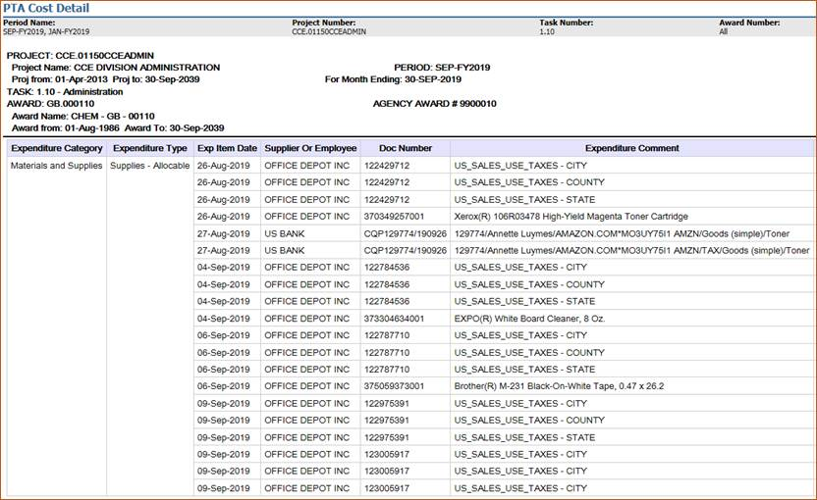
New Data Concepts
Notes:
This screenshot is from a real Cognos PTA Cost Detail (thank you to CCE for allowing us to use it as an example).
You can see how the number of rows can quadruple for a single transaction when the use taxes are calculated.
In addition, you can see the full expenditure comment for the CardQuest charge, both the item line (Toner) and the tax for the item (next line down).

Slide 23
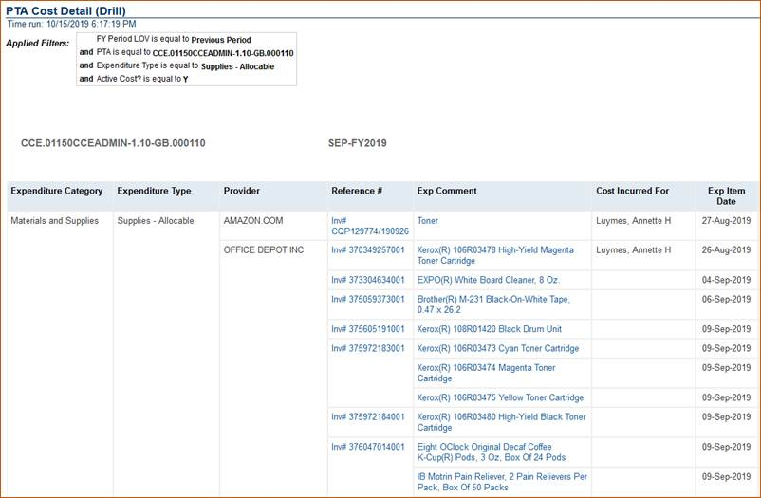
New Data Concepts
Click on blue text to drill
Notes:
This is the OBI PTA Cost Detail (Drill).
Blue text indicates that the user can drill to more detail.
In addition, the lines are rolled up grouped by PTA + FY Period + Expenditure Type + Provider + Reference Number + Exp Comment + Cost Incurred For + Exp Item Date
Since the tax lines have the same Exp Comment as the invoice distribution upon which the tax is calculated, there is only one line rather than four.
Clicking on the Exp Comment will drill to the detail, so you are able to see all individual lines associated with the transaction.
Clicking on the Reference # will drill to the detail for all transactions for that Reference #, FY Period, and PTA combination.

Slide 24
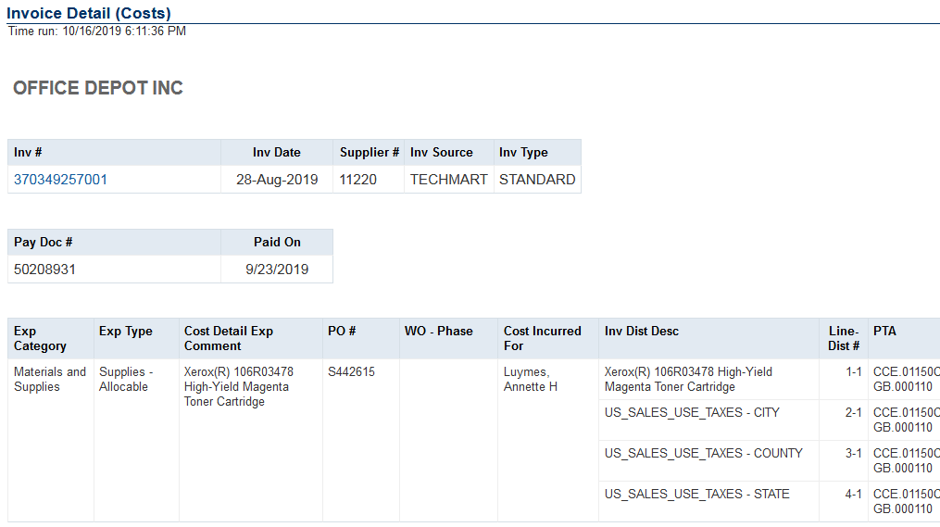
New Data Concepts
Notes:
This is an example of drilling from one line in the previous slide to the invoice associated with that cost.
When you drill from the PTA Cost Detail (Drill) report, which report you drill to is dependent on the source of the transaction. For example:
PO Commitments drill to PO Detail (Commitments), a report that includes information about the purchase order, such as:
PO #, PO Status, Type, Agreement Type, Contract #, and PO Description.
The distribution section includes the Indirect Cost that is calculated on the commitment during the nightly data warehouse load.
Invoice Costs drill to Invoice Details (Costs), which includes:
Information about the invoice, including date, supplier number, source, and type.
The most recent payment information, e.g., if a check is lost and a new one reissued, this report will show you the information about that reissued check.
Invoice distribution information, including all the lines associated with the rolled-up cost from the report.
CardQuest Commitments drill to the CardQuest Detail (Commitments).
CardQuest Costs drill to CardQuest Detail (Costs), which includes:
Invoice #, Invoice Date, and CardQuest Report Name
The distributions include:
Provider
Exp Comment from the Cost Detail
Inv Distribution Description (i.e., the Full Exp Comment from Cognos)
Cost Incurred For
WO – Phase
Web Internal Charges (WIC) and other Internal Charges drill to Internal Charges Detail (Costs).
WIC costs cannot be drilled to from the Exp Comment due to performance reasons.
Includes WIC #, WO-Phase, Cost Incurred For (Customer Name), Charged PTA, and IC Contact or Debit PTA

Slide 25
New Data Concepts
Active?
Y = ALL costs and Current Period commitments
N = Commitments from the Previous Period
Reference #: Identifier for a transaction
PO # and Invoice # for Procurement
WIC # for items entered via the Web Internal Charges
Work Order # for items coming from AiM
Year, Payroll Name, and Payroll # for Payroll
IC Contact or Debit PTA: One column
Credit Transaction = Debit PTA
Debit Transaction = IC Contact
Notes:
Other New Data Concepts
Active?
ONLY use when exporting multiple periods of Cost Details (Active? = Y).
If you are running for a single period, there is no reason to use this filter.
This is a flag that makes it easy to exclude commitments from a previous month.
Y = ALL costs and Current Period commitments.
N = Commitment is from the Previous Period.
Reference #
Identifier for a transaction and based on the source of the transaction.
For procurement costs and commitments, it is either the Invoice # or the PO #.
For Accounts Receivable it is the Receipt #.
For internal charges entered via Web Internal Charges (WIC) it is the WIC #.
For transactions that come from Facilities AiM it is the Work Order #.
For Payroll, regardless if it is a regular pay or an adjustment, it is YEAR Payroll Name Payroll Number, e.g., 2020 Bi-Week 3.
IC Contact or Debit PTA
Single column with a value depending on if the cost is the charge or the credit.
For the credit side of the transaction, the value = Debit PTA, i.e., the PTA that was charged.
For the cost side of the transaction, the value = the IC Contact.
For more information see Data Logic Guide – Cost Details.
NOTE: The Logic is not magic.

Slide 26
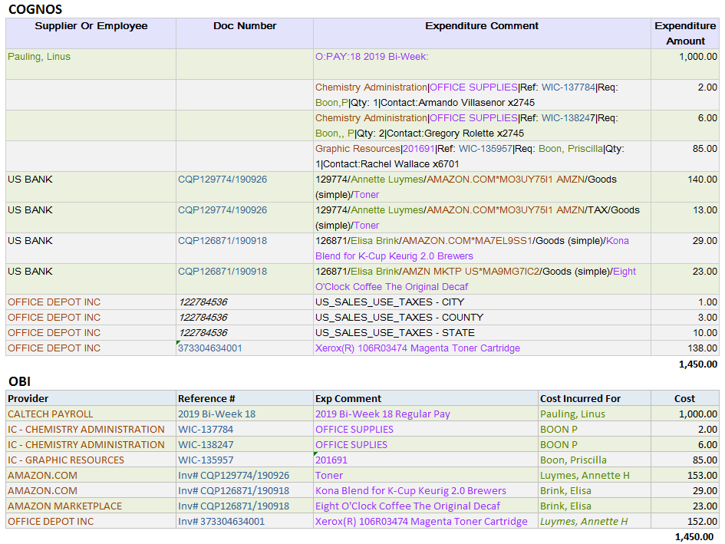
New Data Concepts
Notes:
This screenshot of an Excel spreadsheet shows the mapping of items by color.
The top 2/3s of the picture are line items from Cognos. This data is real EXCEPT for the payroll transaction on the first row.
The Employee from the payroll transaction becomes the Cost Incurred For in OBI (green text)
Check out rows 3, 4, and 5 and how Priscilla Boon’s customer name entry in the WIC gets translated.
Boon,P and Boon,, P both become BOON P and could not be matched to her HR record.
Boon, Priscilla entry, however, could be matched to her HR record.
The Supplier in the first column or information from the Expenditure Comment becomes the Provider in OBI (maroon text).
Notice the Provider names for the IC Charges, Payroll, and the CardQuest transactions.
The Doc Number in the second column or information in the Expenditure Comment or the use taxes associated line’s invoice number becomes the Reference # in OBI (blue text)
A prefix is added to some of the reference numbers to make it easier to know if it is a PO or Invoice.
Note that the Doc Number for the tax lines actually is not the correct invoice number for the tax lines.
The Expenditure Comment or associated invoice distribution line becomes the Exp Comment (purple text).

Slide 27
Accessing the Reports

Slide 28
Accessing the Reports
OBI is Part of access.caltech Single Sign-On
Link: Data Warehouse (OBI)
VPN is Required
Pop-up Windows Must be Allowed for OBI
obi-proxy-prod-a.caltech.edu
Notes:
To access OBI, go to access.caltech, login, scroll down to Data Warehouse (OBI), and click on the link, which will open a new browser tab.
NOTE: In order to use OBI, you must either be on the Caltech internet OR use VPN.
In addition, your browser must allow pop-up windows for OBI, i.e., for obi-proxy-prod-a.caltech.edu.

Slide 29
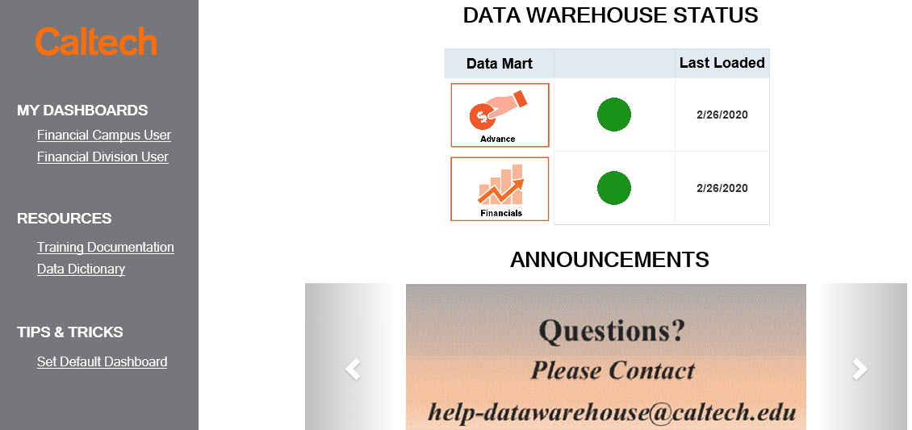
Accessing the Reports
OBI Home Page has Three Sections
Data Warehouse Status at the top-center
Scrolling announcements are at the bottom-center
User roles under MY DASHBOARDS link to Report Listings
Notes:
The status of the Data Warehouse loads is in the top-center of the OBI home page.
The bottom-center has scrolling announcements.
In the gray section on the left are links to the dashboards containing the Report Listings to which you have access.

Slide 30
Accessing the Reports
Clicking on the user role will open the Report Listing for that user role
Each Report Listing has several tabs
Tabs are used to organize the reports and other information
Notes:
Clicking on a User Role under My Dashboards will navigate to the Report Listing dashboard for that user role.
The Report Listings have a series of tabs that are used to organize the reports and other information.

Slide 31
Accessing the Reports
Each Subject Area has a tab
Costs & Commitments
Summaries
Installments
Labor Distribution
Info: Reports about data rather than numbers
Awards
Exp Categories and Types
Funding Sources
Future reports will include information about PTAs and HR Organizations
Notes:
Each of the first few tabs represent a Financials Subject Area. These subject areas include:
Costs & Commitments: A list of reports that are based upon the Costs and Commitments detail.
Summaries: A list of reports based upon PTA financial Budget and Cost information.
Installments: A list of reports based upon Award Installments detail.
The remaining tabs are for other reports and information not specifically for one of the Subject Areas
The Info tab lists reports that are about data not specific to each of the Subject Areas, for example, information about:
Awards
Exp Categories and Types
Funding Sources
In the future there will be reports with information about PTAs or about HR Organizations.

Slide 32
Accessing the Reports
New
List of latest enhancements to OBI Financials
New or modified reports
New user documentation
Help
Training Slides and Video
User and Data Logic Guides
Quick Guides
Report Guides
Tips of the Day
Troubleshooting Guides
Notes:
The New tab lists recent enhancements made to OBI Financials.
The enhancements are listed by date
Tip: Click on this tab each week or so to see if there have been new enhancements made since the last time you checked.
The last tab has a list of user guides including:
Training Slides and Video: Includes the slides used for today, complete with notes.
User and Data Logic Guides: Financial User Guide and documents detailing the logic used for transforming the Financial Data Mart data values.
Quick Guides: Short documents on specific topics, many of which are included in the Financial Data Mart User Guide.
Report Guides: Documents specific to individual reports.
Troubleshooting Guides: Documents to assist with common issues that users may run into

Slide 33
Tips, Hints, and Frequently Asked Questions

Slide 34
Tips and Hints
Embrace the User Documentation
For example, learn how to customize your reports
This investment could save you time overall
Explore the versions of views within a report
Export reports have multiple versions of the data shown
Get to know them before customizing the report
Notes:
Tips and Hints
Embrace the User Documentation
Challenge your assumptions about the data
Learn how to customize reports
This investment could seriously save you time
Explore the versions of views within a report
The reports designed for export to Excel have multiple versions each with different columns included, ordered, etc.
Get to know them BEFORE customizing the report

Slide 35
Tips and Hints
Using Prompts
Sometimes Less is More
Searching for a specific PTA? Don’t also enter Project #.
Too many prompts can decrease performance with no benefit
Use Search for the Prompts
Exporting
Stick to Excel or CSV
Excel: 2,000,000 cells (# of columns X # of rows)
CSV: 500,000 rows
Notes:
Tips and Hints
Using Prompts: Sometimes Less is More
If you are searching for a single PTA there is no reason to enter the Project # or Award # as well
Entering too much could lead to data entry errors
Using Prompts: Use Search for the Prompts
The search offers freedom on character case as well as automatically applying a wildcard at the beginning and end
However, the prompt entered when running the report must be exact, e.g., the correct case, etc.
You’ll also be able to discover alternative versions of values, e.g., BOON P or Boon, Priscilla or Boone Precilla or Preiscilla Boon or Pboon or P Boon, etc.
Exporting
Stick to Excel or CSV because OBI exports the pixel size rather than font size, which means it will be much smaller than expected
Excel: Max output is 2,000,000 cells (e.g., 200,000 rows with 10 columns)
The nice thing is that exporting to Excel keeps all the formatting
CSV: Max output is 500,000 rows, regardless of number of columns
This type of export includes ALL of the columns in the report – even those that are hidden or excluded

Slide 36
FAQ
How Do I Save My Prompts/Filters?
Please see Quick Guide - Saving Prompts and Customizing Reports
Available both on the Help tabs and IMSS web site
How Do I Schedule a Report to be Emailed?
This functionality is not available in OBI
Enhancement request submitted to Oracle
Notes:
Frequently Asked Questions (FAQ)
How Do I Save My Prompts/Filters?
Please see the Quick Guide – Saving Prompts and Customizing Reports
Available on the Help tab as well as the IMSS web site at http://www.imss.caltech.edu/services/administrative-applications/data-warehouse-obi/obi-userguides
Tip: Before you start customizing see the Tip of the Day, Customizing Your Report on the Help tab as well as the IMSS web site at http://www.imss.caltech.edu/documents/17895/TOTD-Customizations.pdf
How Do I Schedule a Report to be Emailed?
This functionality is not available in OBI
Enhancement request has been submitted to Oracle, but not likely to happen

Slide 37
FAQ
What is the Cognos Timeline?
GA and LD Reports in Cognos are No Longer Supported
This includes reports such as PTA Cost Details, PTA Summaries, LD Query, and LD Schedule Lines
HR and PO/AP Continue to be Supported
Notes:
Frequently Asked Questions (FAQ)
What is the Cognos Timeline?
Reports in the Cognos Grants Accounting (GA) and Labor Distribution data marts are no longer supported
This includes reports such as the PTA Cost Details, PTA Summaries, LD Query, and LD Schedule Lines
HR and PO/AP data marts in Cognos continue to be supported

Slide 38
Caltech Financials Data Warehouse help-datawarehouse@caltech.edu OBI Training Documentation OBI Training Schedule
Notes:
For more information about OBI please see the user documentation on the Help tabs or go to:
Questions, issues, and requests for enhancements may be sent to help-datawarehouse@caltech.edu
OBI User Documentation: http://imss.caltech.edu/services/administrative-applications/data-warehouse-obi/obi-userguides
OBI Training: http://www.imss.caltech.edu/services/administrative-applications/data-warehouse-obi/obi-training-schedule

